Slide 1
Grading 101
GPHS

Slide 2
WHEN A NEW STUDENT ENROLLS - Perfect Scenario
Registrar’s office completes a New Student Worksheet (NSW) that lists the courses taken at the previous school as well as their transfer grades from the previous school.
Counselors then match identically as many classes as they can for each student and send the NSW to all teachers.
Teachers should then complete a grade change request through skyward to enter the transfer grade for all previous grade reporting periods. Include a citizenship grade for all periods.
** Remember most other HS’s offer 7 classes so there is rarely a perfect match!!

Slide 3
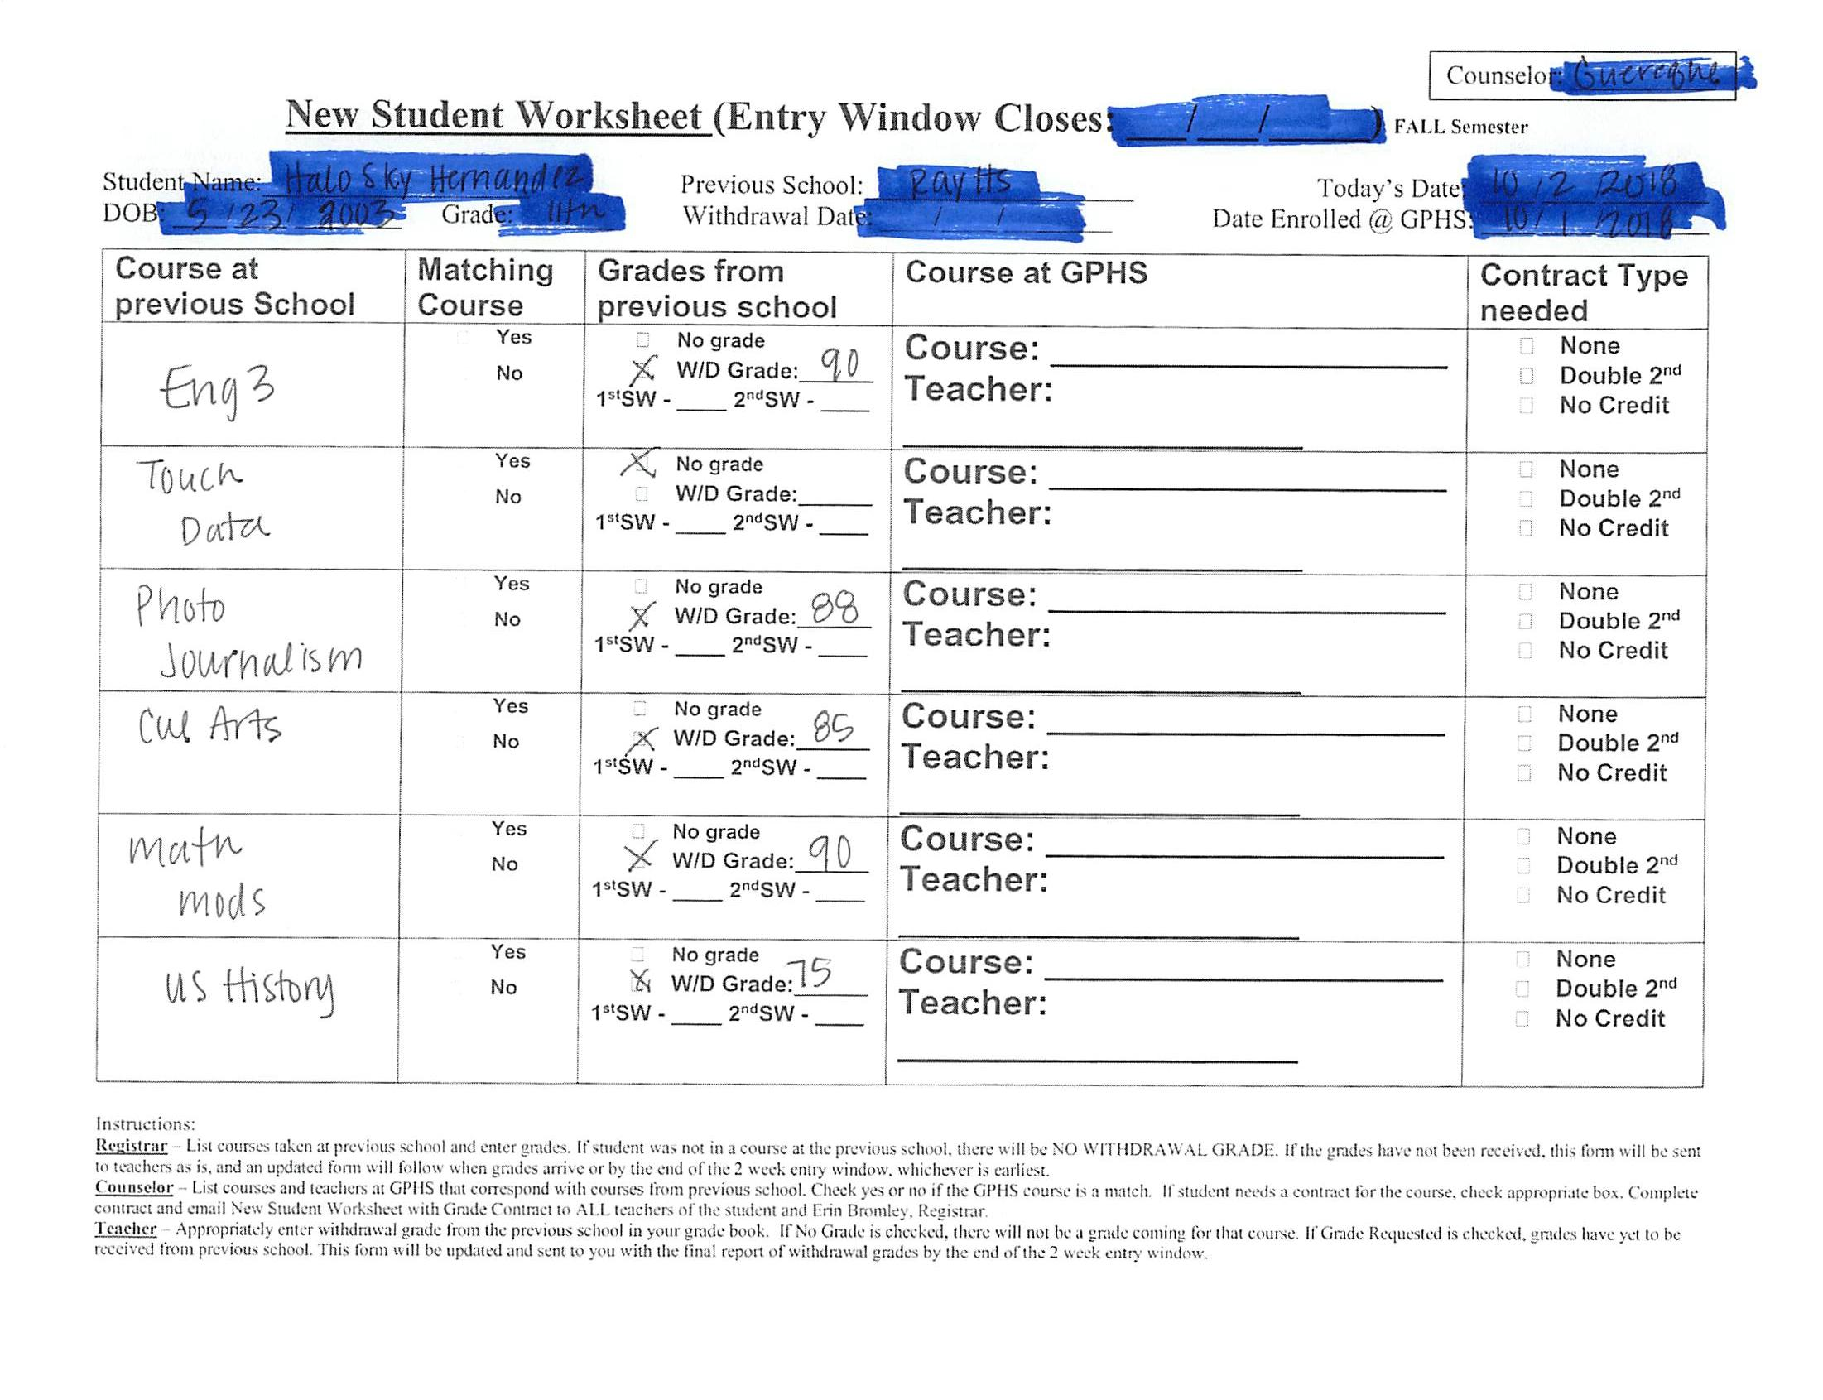
Almost perfect scenario -
See transfer grades for everything except Touch Data.

Slide 4
When a new student enrolls . . .
Who hasn’t been in school anywhere and it is before the middle of a semester
The registrar’s office will complete a NSW and you will receive a grade contract for that student.
The contract will ask you to double the six weeks grade.
Select any placeholder grade you would like and enter that for all previous grading windows.
Once the second six weeks ends you will need to enter the grade the student earned for the 2nd six weeks in all previous grading windows. Be sure to add a citizenship grade.
Who hasn’t been in school anywhere and it is after the middle of a semester
The registrar’s office will complete a NSW and you will receive a grade contract for that student.
The contract will tell you and the family that the student will be taking the class for no credit.
Select any placeholder grade you would like and enter that for all previous grading windows. Be sure to add a citizenship grade.
The registrar will remove the credit at the end of the semester regardless of grade.

Slide 5
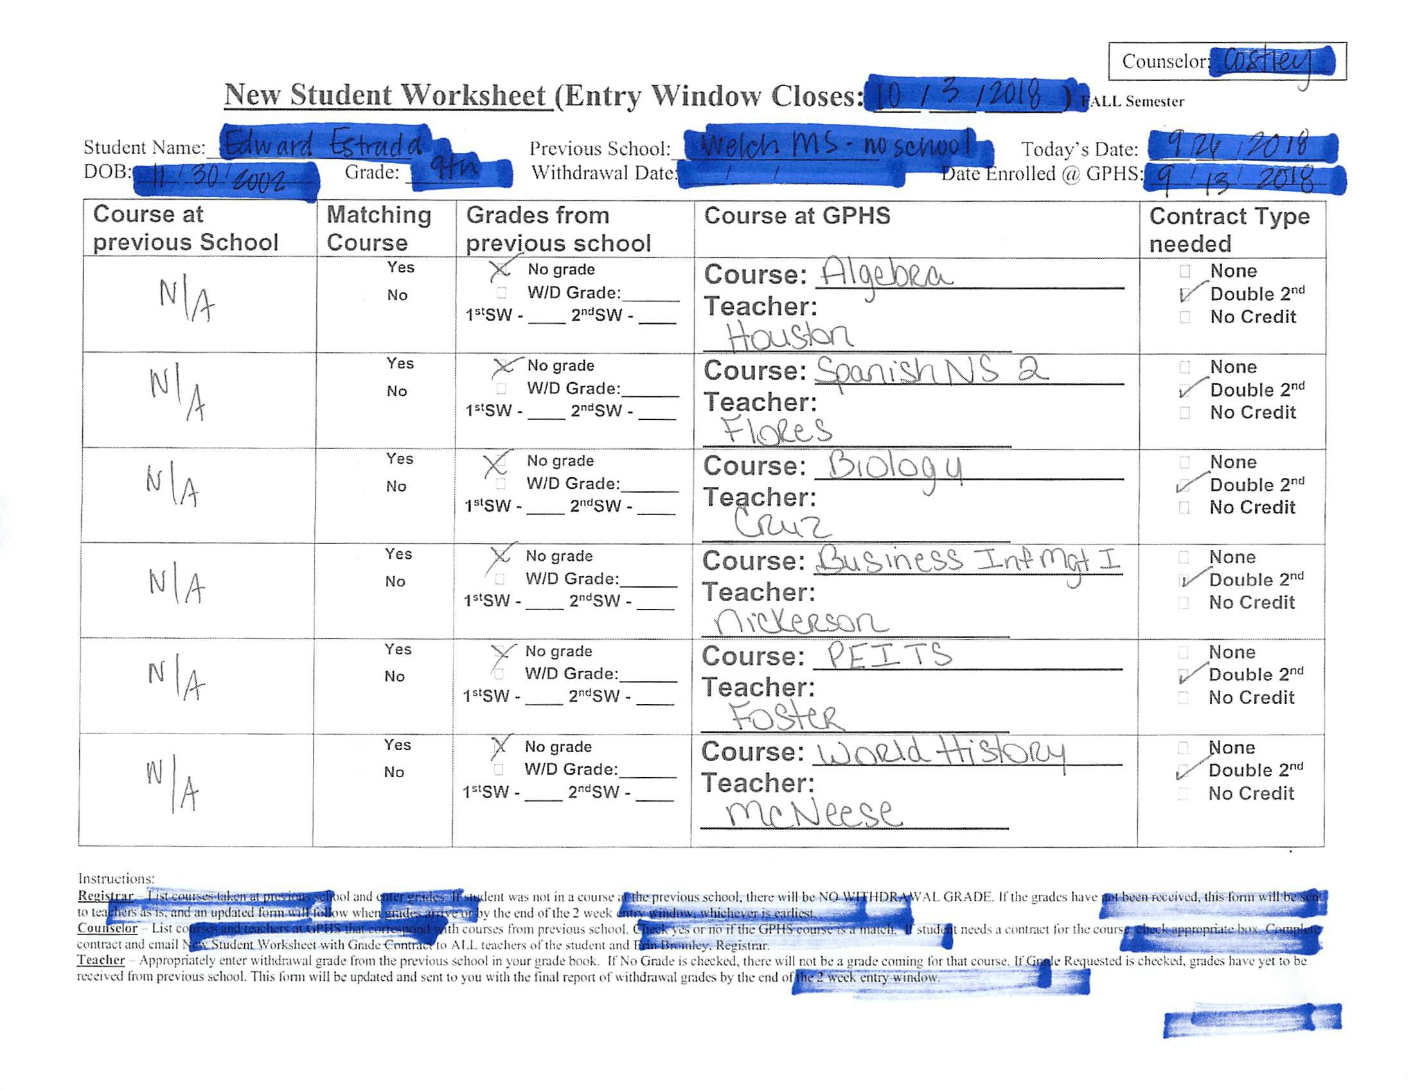
No transfer grades available because the student has not been in school.
Use a placeholder until the end of the contract window.

Slide 6
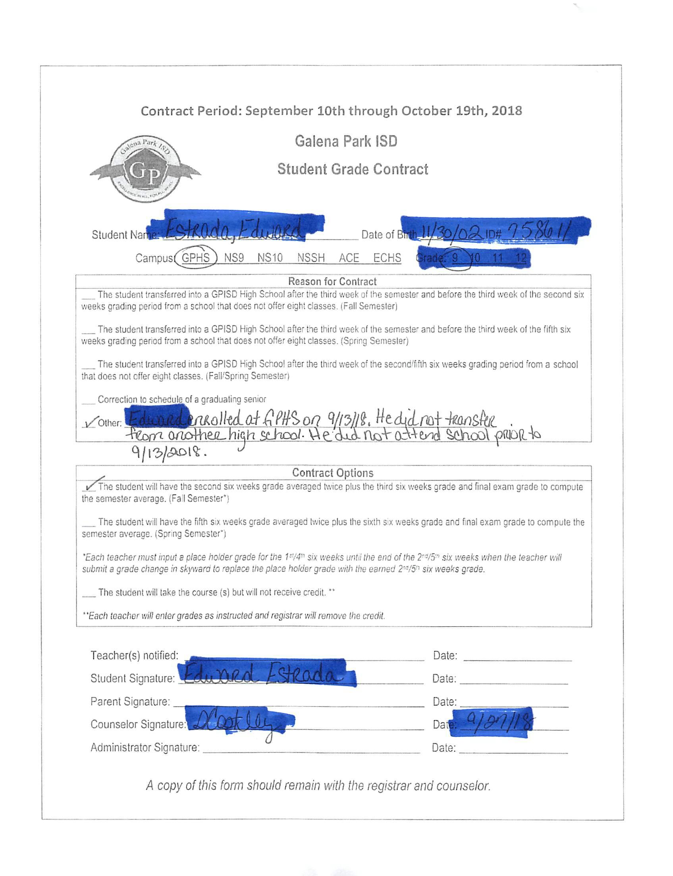
Sample contract

Slide 7
New Procedures to avoid blank grades.
2018-19

Slide 8
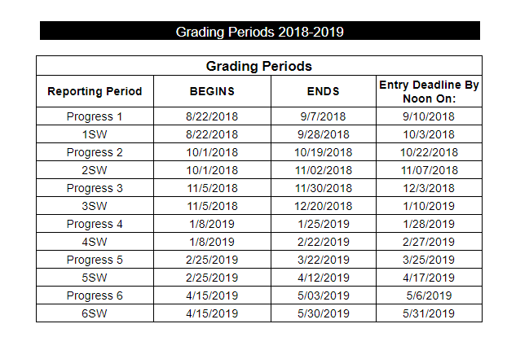
Mark your calendar -
Proof sheets & call logs will be due to your Appraiser by 3pm on the date that the grading period ends.
You will still be able make changes until the entry deadline.
No schedule changes are allowed from the beginning of the grading window until the entry deadline.

Slide 9
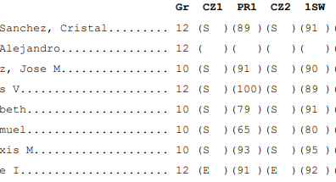
How to print proof sheets
Open any gradebook.
Click on reports
Under Report Cards you will see the grade proof sheet report.
Select the last term in the drop down. Be sure that you have not placed a check mark in any box on this screen.
Select classes to view report and check ALL classes.
Select Print.
Check for ANY blanks.
You will have to complete a grade change request form for any blank in a previous window. https://drive.google.com/file/d/11anY4fg-LkZUtJaJj0Po_ziObpgeHFoO/view
Submit your proof sheets by the deadline AFTER ensuring you have no blanks.
Please draw a line through the dropped students. Those students will have the word dropped next to their name.
Blanks grades

